Slide 1

Alien Apocalypse – FYP
Davids Jalisevs
C00239534

Slide 2
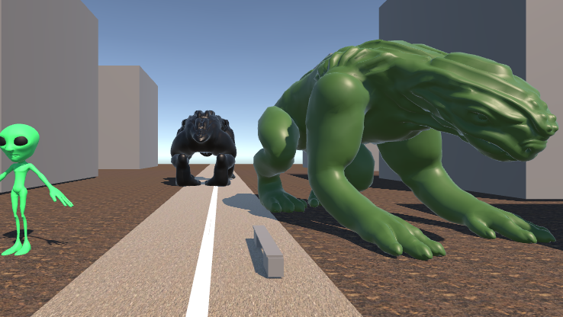
Content Table
Introduction
Gameplay
Features
Challenges and goals
Possible Game Patterns to use
Conclusion

Slide 3
Introduction
In the “Alien Apocalypse” player must use their acquired through the world powers to either fight against the invading alien forces and save humanity or join the aliens and destroy humanity. With dynamic gameplay and unique superpowers player will get to experience either super-hero path or a villain.

Slide 4
Gameplay

Slide 5
Dynamic Super-Powers
In this game I want to implement as much as possible of interesting super-powers I always wanted to have as a kid, the list goes on and on but to mention I will try my best to implement following powers in time
Fireball: shoot a fire ball, set things on fire
Telekinesis: The ability to move objects from afar
Terrain manipulation: edit, delete and build environment around
Flight: player able to fly around in 3d space
Super strength: super fists with big power
Shockwave: creates a wave that stuns opponents around you

Slide 6
Dynamic Path
Player will be able to select his path on either attack aliens and save humanity or to join aliens and erase humanity using acquired superpowers,
Humanity will consider player enemy and will also start their attack on the player
Wanted system to treat player if player goes too crazy on humans
Dynamic events such as meteor crushing or tornadoes

Slide 7
Features To Be
Superpowers: Players can collect and upgrade a variety of unique superpowers, such as telekinesis, Fireball, and super strength.
Choice-based gameplay: Players can choose whether to fight against the invading aliens or join forces with them and attack humanity.
Survival Game mode: Infinite alien attack just against the player.
Interactive environments: The game world is fully interactive, allowing players to use their abilities to manipulate the environment.
Upgradable abilities: Players can level up their abilities and unlock new abilities as they progress through the game.

Slide 8

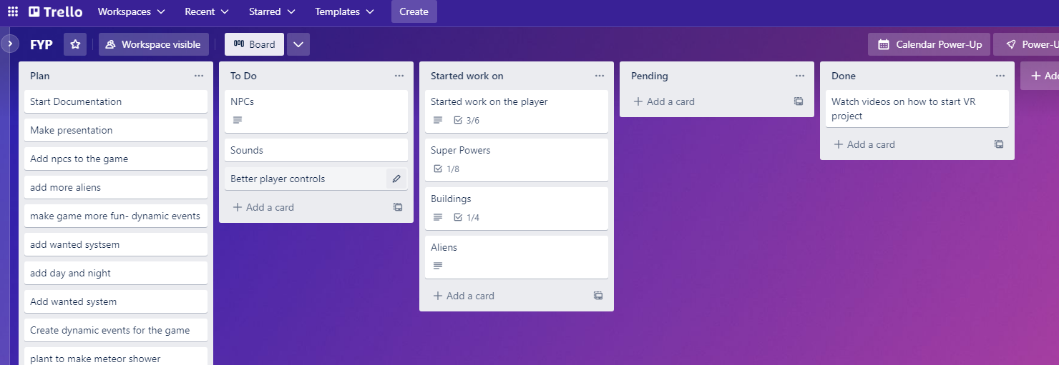

Trello Board

Slide 9
Challenges and goals

Slide 10
Challenges
Balancing - Creating a wide variety of unique and powerful superpowers that player can use in combat and exploration. This will require careful design and balance to ensure that each power is interesting and useful, without making any one power overpowered.
Work with AI –developing different AI`s for enemies and npc`s that will make all enemies look different and act different, and will make npc`s look more alive.
Dynamic events - Implementing a dynamic and interactive world that changes over time and responds to the player's actions.

Slide 11
Goals
To create intelligent and challenging alien enemy AI that adapts to the player's actions and tactics, and that provides a fun and satisfying challenge for players.
Learn more about Unity Engine and virtual reality.
To designing and implement a diverse range of superpowers, each with its own distinct mechanics and effects

Slide 12
Possible game patterns to use
The Singleton pattern, which ensures that only one instance of a particular object or class exists in the game at any given time. This could be useful for creating global objects or resources that need to be shared across multiple parts of the game.
The Strategy pattern, which allows players to choose from a variety of different tactics or strategies in the game, and to switch between them as needed. This could be useful for creating a system of customizable player builds or loadouts
The State pattern, which allows objects in the game to change their behavior depending on their internal state. This could be useful for creating complex and dynamic AI behavior, or for allowing player to switch between different superpowers in combat.

Slide 13
Conclusion
In conclusion, "Alien Apocalypse" is a game where player must use their acquired superpowers to either fight against the invading alien forces and save humanity, or join the aliens and destroy humanity. With dynamic gameplay and unique superpowers, the game offers player the opportunity to experience the thrill of being a super-hero or a villain.
I hope to learn new technologies and techniques, such as artificial intelligence and maybe machine learning, and how to apply them to create a dynamic and interactive game world.
Overall, by developing this game, I hope to gain a deeper understanding of game design and development, and to advance my skills as a game developer.

Slide 14
Thank you
Davids Jalisevs
C00239534
https://youtu.be/h5Q4yvxdV34

